Slide 1


Department of Computer Science and Engineering
GE19612-Professional Readiness for Innovation, Employability and Entrepreneurship
DOC_ACTOR
Dr.K. Ananthajothi M.E.,Ph.D.,
LINGESH N (2116210701133)
MOHAMED BASMAN M (21162107011)
LOKESH E(2116210701135)

Slide 2
Abstract
This project proposes the development of an AI-powered telemedicine platform, combining voice recognition, NLP, video conferencing, and authentication mechanisms. By integrating these technologies, the system enables remote consultations between patients and healthcare providers, enhancing medical accessibility. Robust database interactions ensure secure storage of patient and doctor information, while fingerprint authentication enhances security. The structured project approach facilitates seamless implementation and scalability. Through advanced AI models and stringent security measures, the platform aims to improve healthcare access and patient outcomes. This project aligns with the growing demand for remote healthcare solutions, particularly in underserved areas or during crises. By leveraging technology, it addresses the evolving needs of the healthcare industry and contributes to better healthcare delivery worldwide.

Slide 3
Existing System
In the existing healthcare system, reliance on in-person consultations poses limitations, particularly in remote or underserved regions, exacerbating disparities in medical access. Timely diagnosis and treatment are often hindered by geographical barriers, contributing to delays in patient care. Moreover, conventional healthcare models face challenges meeting the surging demand for remote services, notably evident during pandemics. These limitations underscore the urgent need for innovative solutions that transcend physical boundaries, ensuring equitable access to healthcare expertise regardless of location. By harnessing emerging technologies and telemedicine platforms, healthcare delivery can evolve to meet the evolving needs of patients, offering timely interventions and improving overall health outcomes.

Slide 4
Proposed System
The proposed AI-assisted telemedicine system presents a transformative approach to healthcare delivery, leveraging state-of-the-art technologies to bridge geographical and logistical gaps between patients and healthcare providers. Through seamless integration of advanced tools like voice recognition, natural language processing (NLP), and video conferencing, the system empowers remote consultations, ensuring prompt access to specialized medical expertise irrespective of physical location. Robust database management coupled with stringent security measures, including fingerprint authentication, fortifies data privacy and integrity, instilling confidence in patients and healthcare professionals alike. By embracing innovation as its cornerstone, this forward-looking system not only enhances medical accessibility but also anticipates and addresses evolving patient needs, ultimately striving to elevate healthcare standards and improve overall patient outcomes in an ever-changing healthcare landscape.

Slide 5
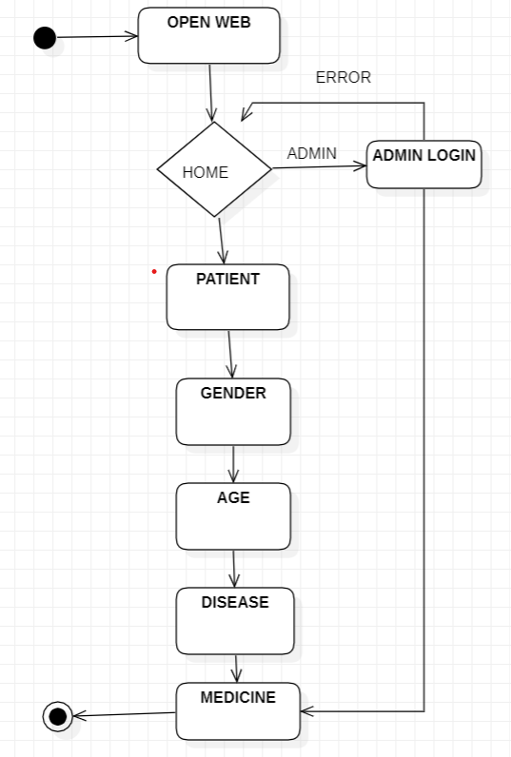
System Architecture

Slide 6
List of Modules
Voice Service Module
NLP Service Module
Video Service Module
Authentication Service Module
Database Service Module

Slide 7
List of Modules
Routes Module
Patient Model
Doctor Model
Consultation Model
HTML Template Module

Slide 8
Functional Description for each modules
Voice Service Module (voice_service.py):
This module handles the conversion of voice data into text using speech recognition techniques.
It ensures error handling and accuracy in transcribing audio inputs to text format, enabling further analysis.
NLP Service Module (nlp_service.py):
The NLP service module focuses on analyzing the text data processed by the voice service, specifically in the context of medical terminology.
It utilizes natural language processing techniques to extract relevant information from patient inputs, aiding in the identification of medical conditions or symptoms.

Slide 9
Functional Description of Module
. Video Service Module (video_service.py):
This module facilitates the setup and management of video calls between patients and healthcare providers.
It integrates with external services (e.g., Twilio) to enable real-time communication, ensuring seamless remote consultations.
Authentication Service Module (auth_service.py):
The authentication service module implements various authentication mechanisms, such as fingerprint authentication, to ensure secure access to the telemedicine system.
It verifies the identity of users before granting access to sensitive features, enhancing overall system security.

Slide 10
Functional Description of Module
. Database Service Module (db_service.py):
Responsible for handling database interactions, this module ensures reliable storage and retrieval of patient, doctor, and consultation data.
It manages database connections, executes queries, and handles errors to maintain data integrity and robustness.
Routes Module (telemedicine_routes.py):
The routes module defines the endpoints and routes for handling various functionalities of the telemedicine system.
It integrates all services and orchestrates their interactions based on incoming requests, ensuring proper communication between client and server.

Slide 11
Functional Description of Module
. Patient Model (patient.py):
This model defines the structure and behavior of patient objects within the system.
It stores information about patients, including their name, fingerprint data, and other relevant details.
Doctor Model (doctor.py):
Similar to the patient model, the doctor model defines the structure and behavior of doctor objects.
It stores information about doctors, such as their name, specialty, and any other pertinent information.

Slide 12
Functional Description of Module
Consultation Model (consultation.py):
The consultation model encapsulates the structure and functionality related to consultations between patients and doctors.
It stores information about consultations, including patient ID, doctor ID, medical problem, and other relevant details.
HTML Template Module (index.html):
This module provides a simple HTML interface for user interaction with the telemedicine system.
It includes elements such as forms for submitting voice inputs and interfaces for displaying information, enhancing user experience and accessibility.

Slide 13
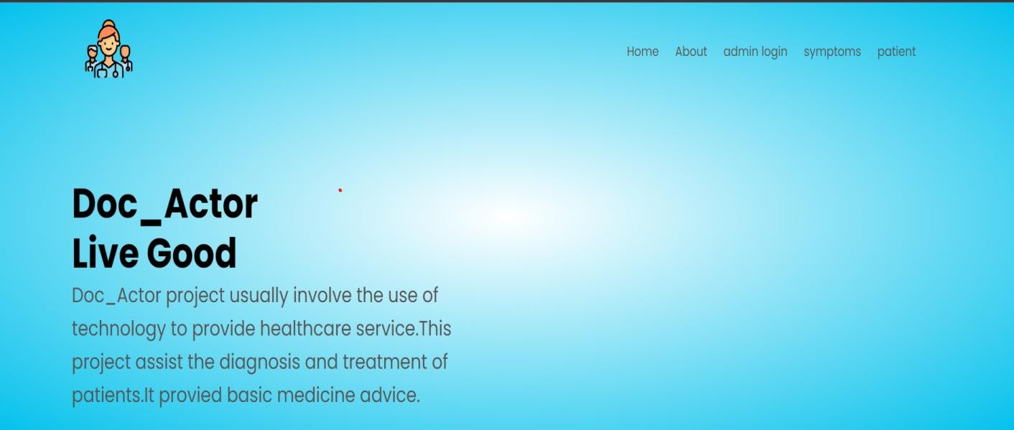
HOME PAGE

Slide 14
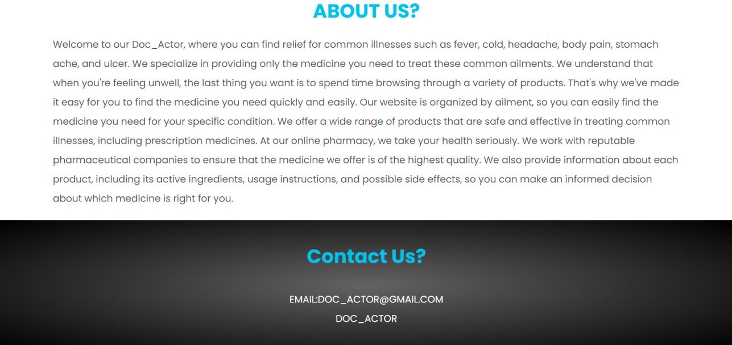
ABOUT :

Slide 15

PATIENT LOGIN:

Slide 16
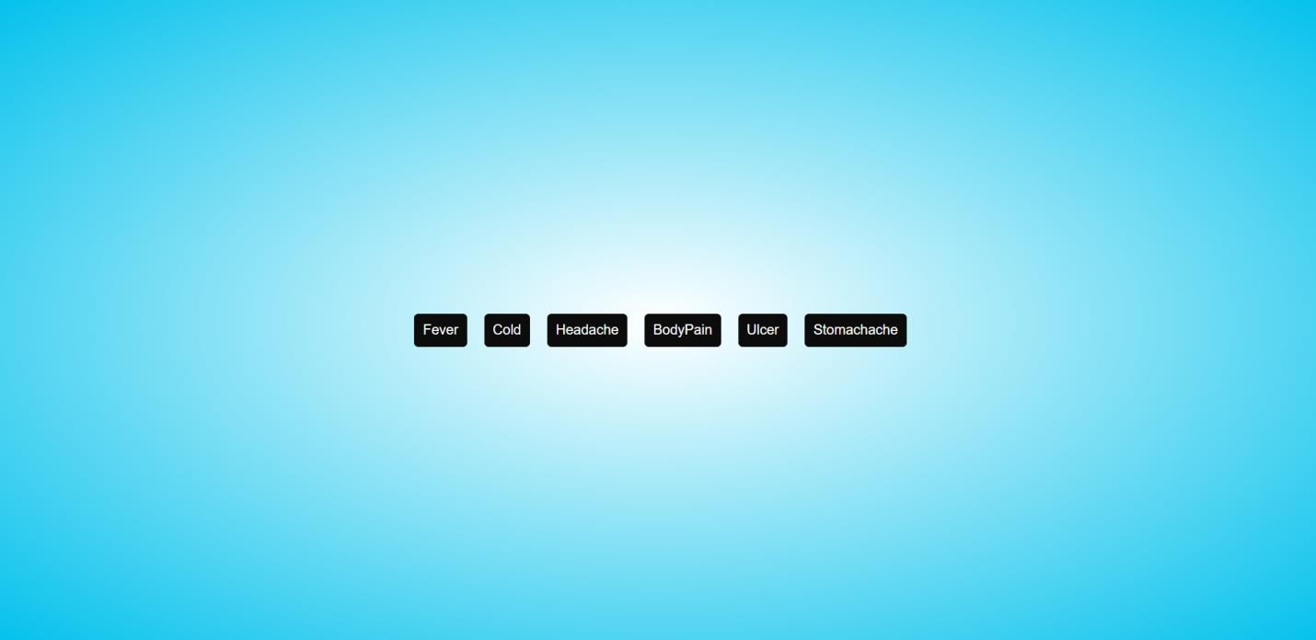
DISEASES:

Slide 17
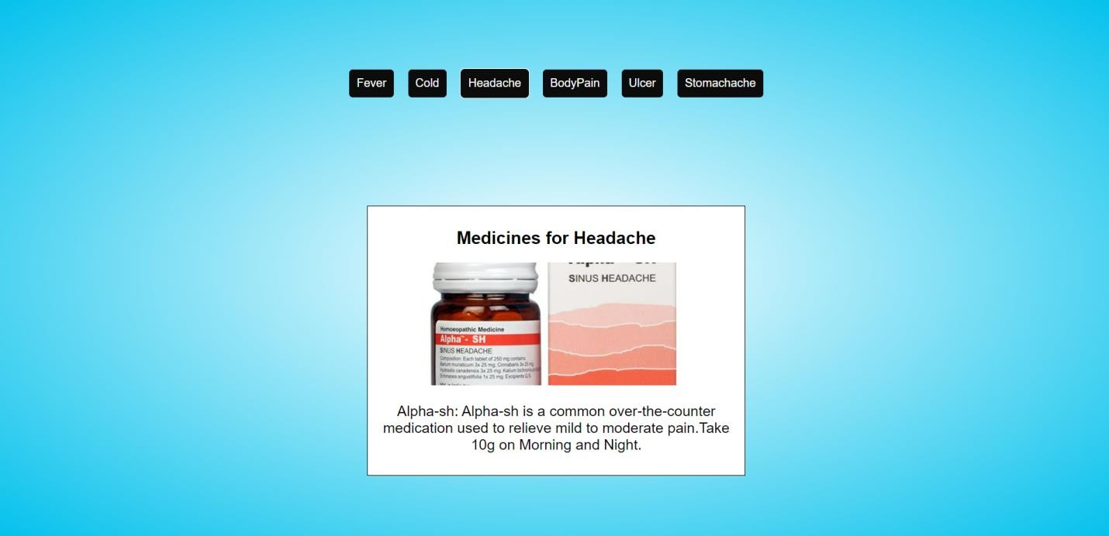
OUTPUT:

Slide 18
Conclusion
The AI-assisted telemedicine project presents a comprehensive solution to modernize healthcare delivery. By integrating advanced technologies like voice recognition, NLP, and video conferencing, it aims to enhance medical accessibility and patient care. The modular architecture, comprising various services and models, ensures flexibility and scalability. Security measures such as fingerprint authentication and robust database management prioritize patient data privacy and integrity. This project addresses the limitations of traditional healthcare models, particularly in remote or underserved areas. Its adaptability to evolving healthcare needs positions it as a valuable asset in future healthcare systems. Through innovation and technology, it strives to improve healthcare outcomes and patient experiences, ultimately shaping the future of healthcare delivery.

Slide 19
References
1. Smith, A., & Thomas, D. (2020). "Telemedicine: A New Frontier in Healthcare Delivery." In Proceedings of the International Conference on Computational Science and Its Applications (pp. 237-248). Springer, Cham.
2. Bashshur, R. L., Shannon, G. W., & Bashshur, N. (2019). "The Empirical Evidence for Telemedicine Interventions in Mental Disorders." Telemedicine and e-Health, 25(6), 433-437.
3. Hollander, J. E., & Carr, B. G. (2020). "Virtually Perfect? Telemedicine for Covid-19." New England Journal of Medicine, 382(18), 1679-1681.
4. Ohannessian, R., Duong, T. A., & Odone, A. (2020). "Global Telemedicine Implementation and Integration Within Health Systems to Fight the COVID-19 Pandemic: A Call to Action." JMIR Public Health and Surveillance, 6(2), e18810.

Slide 20
References
5. Bashshur, R., Doarn, C. R., Frenk, J. M., Kvedar, J. C., Woolliscroft, J. O., & Yellowlees, P. (2020). "Telemedicine and the COVID-19 Pandemic, Lessons for the Future." Telemedicine and e-Health, 26(5), 571-573.
6. Wang, H., Jin, Y., & Wang, Y. (2020). "Globally Exploiting Telemedicine for Pulmonary Rehabilitation During the COVID-19 Pandemic." Telemedicine and e-Health, 26(12), 1469-1473.
7. Okoniewska, B. M., Santana, M. J., & Holroyd-Leduc, J. (2020). "Patient Telemedicine Portal Use for Caregiver-Involved Geriatric Assessment Visits: Secondary Analysis of a Randomized Controlled Trial." JMIR Aging, 3(1), e21666.
8. Bhat, S., & Yathiraj, A. (2021). "Impact of COVID-19 on the Adoption of Telemedicine and its Challenges." Journal of Critical Reviews, 8(1), 380-384.

Slide 21
References
9. Telemedicine and Telehealth Service Provider Market, 2020-2027 (2021). Retrieved from https://www.grandviewresearch.com/industry-analysis/telemedicine-industry.
10. Medicare Telemedicine Health Care Provider Fact Sheet. (n.d.). Centers for Medicare & Medicaid Services. Retrieved from https://www.cms.gov/newsroom/fact-sheets/medicare-telemedicine-health-care-provider-fact-sheet.
11. AMA Digital Health Study: Physicians' Motivations and Requirements for Adopting Digital Health. (2019). American Medical Association. Retrieved from https://www.ama-assn.org/system/files/2019-04/ama-digital-health-study.pdf.
12. Bashshur, R. L., & Doarn, C. R. (2019). "Changes in Telemedicine Reimbursement in the United States in the 2010s." Telemedicine and e-Health, 25(8), 649-651.

Slide 22
Thank You

